Slide 1
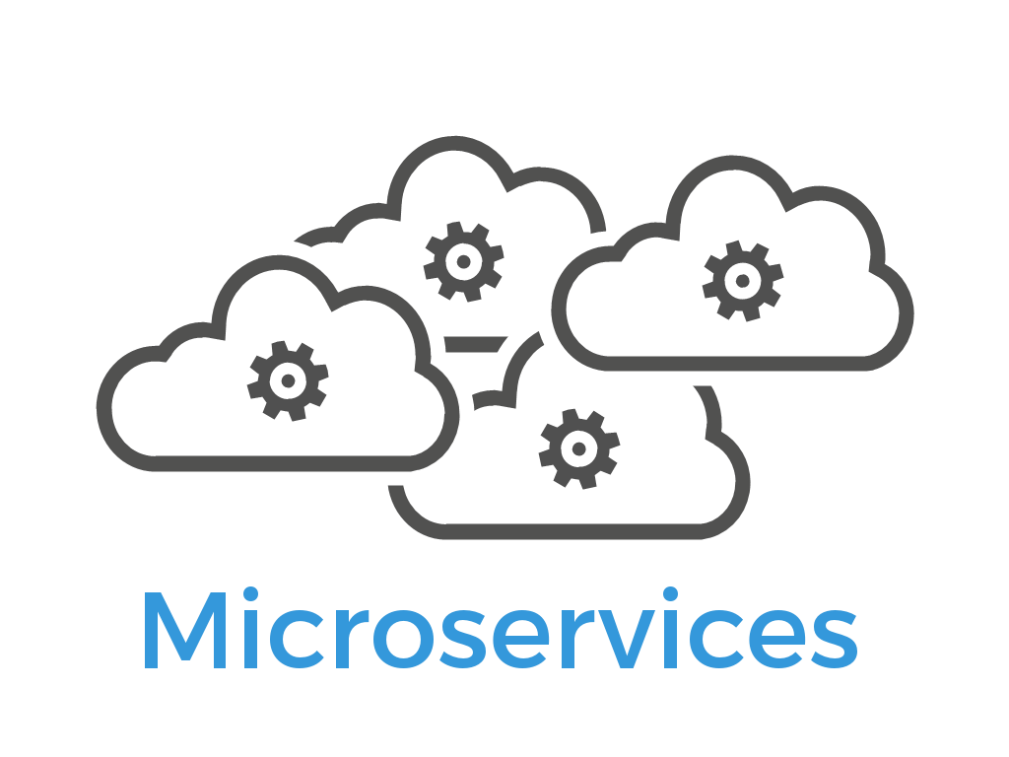
Microservices

Slide 2
Monolithic Systems
Coupling is high throughout the codebase
Hidden coupling between subcomponents
Deploying the application is a lengthy process
involve several people and system downtime
The system has a one-size-fits-all architecture
least complex parts of the system will be overengineered

Slide 3
What is a microservice?
A microservice is a service with one, and only one, very narrowly focused capability that a remote API exposes to the rest of the system.

Slide 4
What is capability?
Each little capability in the system is implemented as an individual microservice.
Every microservice in a system
Runs in its own separate process
Can be deployed on its own, independently of the other microservices
Has its own dedicated data store
Collaborates with other microservices to complete its own action

Slide 5
Please Note…
It’s important to note that microservices don’t need to be written in the same programming language (C#, Java, Erlang, and so on)
or
for the same platform (IIS, Node, NGINX, and so on) as ones they collaborate with.
They just need to know how to communicate with each other.
Via a service bus
Via binary protocol like Thrift,
Most common scenario is for microservices to communicate over HTTP.

Slide 6
What is a microservices architecture?
Designing and implementing individual microservices.
Microservices can also be used to describe an architectural style for an entire system consisting of many microservices.
Microservices as an architectural style is a lightweight form of service-oriented architecture.
System with a microservices architecture is a distributed system with a (probably large) number of collaborating microservices.

Slide 7
Microservice characteristics
A microservice is responsible for a single capability.
A microservice is individually deployable.
A microservice consists of one or more processes.
A microservice owns its own data store.
A small team can maintain a handful of microservices.
A microservice is replaceable.

Slide 8
RESPONSIBLE FOR A SINGLE CAPABILITY
SRP – Single Responsibility Principle (OOP)
A microservice has a single responsibility.
That responsibility is for a capability.

Slide 9
Uncle Bob’s way
Uncle Bob states: “Gather together the things that change for the same reasons. Separate those things that change for different reasons.”
This way of stating the principle applies to microservices: a microservice should implement exactly one capability.
That way, the microservice will have to change only when there’s a change to that capability.

Slide 10
Capability Types
A business capability is something the system does that contributes to the purpose of the system, like keeping track of users’ shopping carts or calculating prices.
A technical capability is one that several other microservices need to use, like integration to some third-party system.

Slide 11
INDIVIDUALLY DEPLOYABLE
A microservice should be individually deployable.
When you a change a microservice, you should be able to deploy that changed microservice to the production environment without deploying (or touching) any other part of your system.
Other microservices in the system should continue running and working during the deployment of the changed microservice, and continue running once the new version is deployed

Slide 12
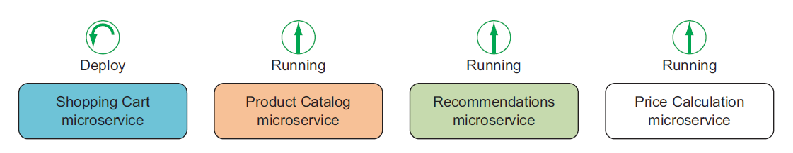
INDIVIDUALLY DEPLOYABLE

Slide 13
CONSISTS OF ONE OR MORE PROCESSES
Each microservice must run in separate processes from other microservices
Each microservice can have more than one process.

Slide 14
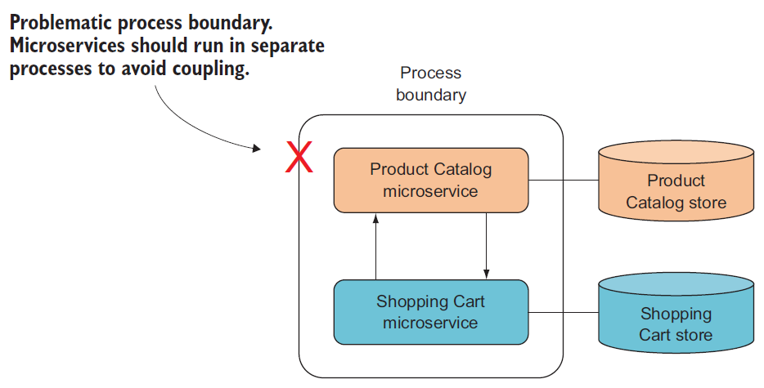
Notes:
Consider a Shopping Cart microservice again. If it ran in the same process as a Product Catalog microservice, as shown in figure, the Shopping Cart code might cause
a side effect in the Product Catalog. That would mean a tight, undesirable coupling
between the Shopping Cart microservice and the Product Catalog microservice; one
might cause downtime or bugs in the other.
Now consider deploying a new version of the Shopping Cart microservice. You’d
either have to redeploy the Product Catalog microservice too, or you’d need some
sort of dynamic code-loading capable of switching out the Shopping Cart code in the
running process.

Slide 15
OWNS ITS OWN DATA STORE
A microservice owns the data store where it stores the data it needs.
If each microservice owns its own data store makes it possible to use different database technologies for different microservices depending on the needs of each microservice.

Slide 16
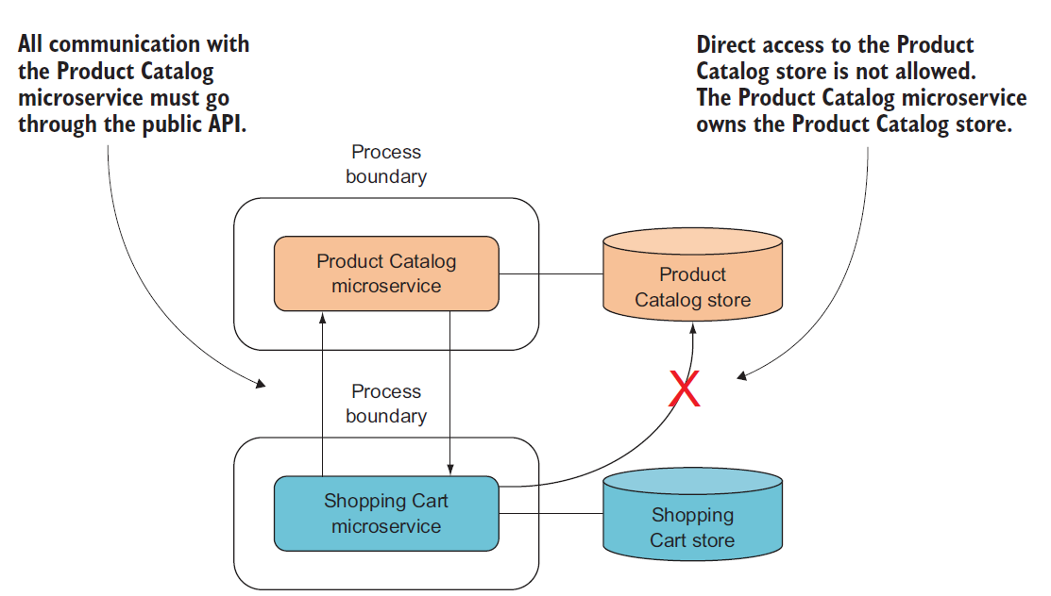
Notes:
One microservice can’t access another’s data store

Slide 17
MAINTAINABLE BY A SMALL TEAM
Maintaining a microservice means dealing with all aspects of
Keeping it healthy and fit for use
Developing new functionality
Factoring out new microservices from ones that have grown
Running it in production
Monitoring, Testing & fixing bugs

Slide 18
REPLACEABLE
The team maintaining the microservice should be able to replace the current implementation with a completely new implementation and do so within the normal pace of their work.
This characteristic is another constraint on the size of a microservice: if a microservice grows too large, it will be expensive to replace; but if it’s kept small, rewriting it is realistic.

Slide 19
Why microservices?
Enable continuous delivery
Allow for an efficient developer workflow because they’re highly maintainable
Are robust by design
Can scale up or down independently of each other

Slide 20
Costs and downsides of microservices
Significant costs are associated with choosing a microservices architecture
Microservice systems are distributed systems
Microservice systems are made up of many microservices
Each microservice is a separate codebase

Slide 21
Questions to ask?
Would this system benefit from the ability to deploy subsystems separately?
Can you build sufficient deployment automation?
Are you sufficiently knowledgeable about the domain to properly identify and separate the system’s various independent business capabilities?
Is the system’s scope large enough to justify the complexity of a distributed architecture?
Is the system’s scope large enough to justify the cost of building the deployment automation?
Will the project survive long enough to recover the up-front investment in automation and distribution?

Slide 22
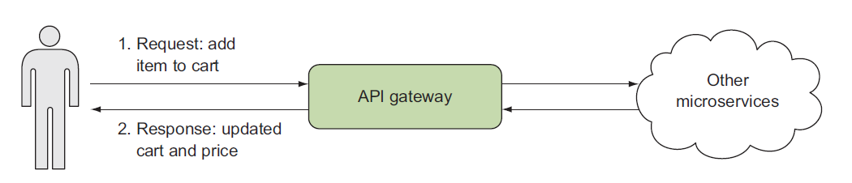
How Microservice works?

Slide 23
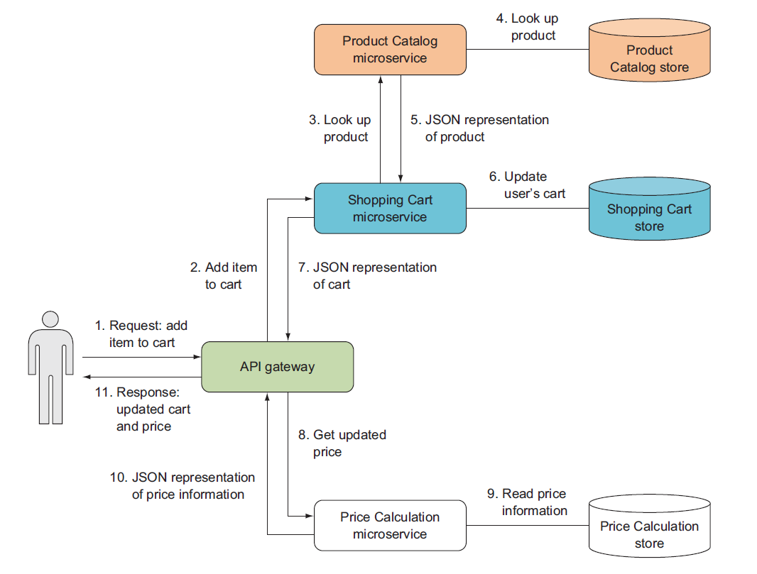

Slide 24
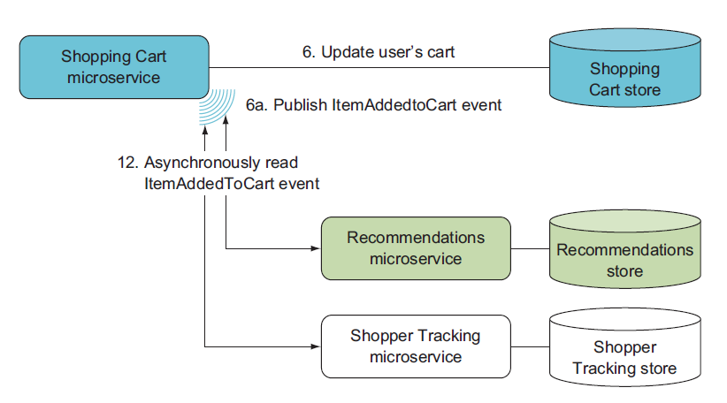
React to Events Asynchronously

Slide 25
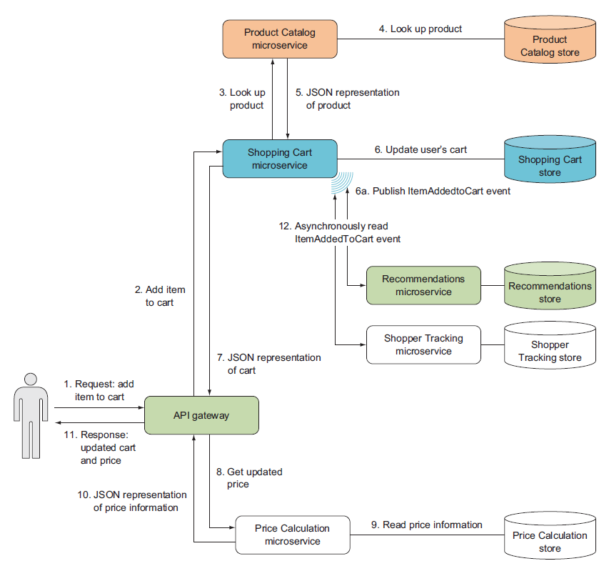

Slide 26
Technology Stack
Web API
https://www.asp.net/web-api
Nancy
http://nancyfx.org/
OWIN
http://owin.org

Slide 27
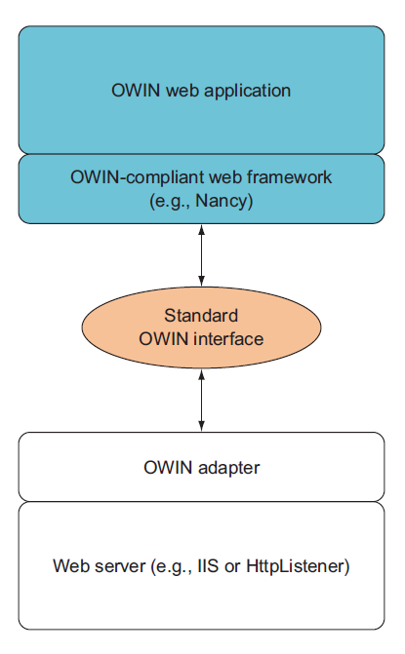
OWIN
The Open Web Interface for .NET
OWIN decouples the web server and the web application from each other

Slide 28
Development Environment Setup
An IDE – Visual Studio 2019
Tool for making HTTP requests – Postman
Database – SQL Server Express
We can run .Net Core Apps from Command Prompt to do so, you need .Net Core Installer - https://www.microsoft.com/net

Slide 29
Microservice Collaboration
There are three types of microservice collaboration:
Command-based collaboration, where one microservice uses an HTTP POST or PUT to make another microservice perform an action.
Query-based collaboration, where one microservice uses an HTTP GET to query the state of another microservice
Event-based collaboration, where one microservice exposes an event feed that other microservices can subscribe to by polling the feed for new events
Notes:
Event-based collaboration is more loosely coupled than command- and querybased collaboration.
You can hook into Nancy’s model binding and content negotiation to support data formats other than XML and JSON.
The Nancy bootstrapper is used to configure Nancy itself and Nancy applications.
You can use HttpClient to send commands to other microservices and to query other microservices.
You can use Nancy to expose the endpoints for receiving and handling commands and queries.
Nancy can expose a simple event feed.
You can create a process that subscribes to events by
– Creating a .NET Core console application
– Implementing and installing a console application as a Windows service
– Using a timer to make the console application poll an event feed
– Using HttpClient to read events from an event feed

Slide 30
How to maintain State of your Service?

Slide 31
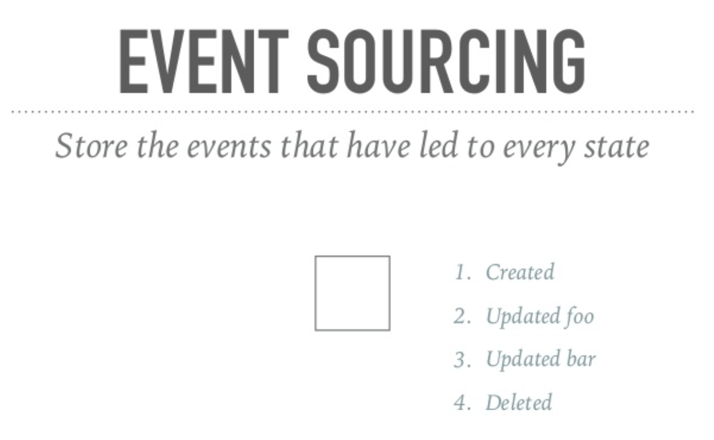

Slide 32
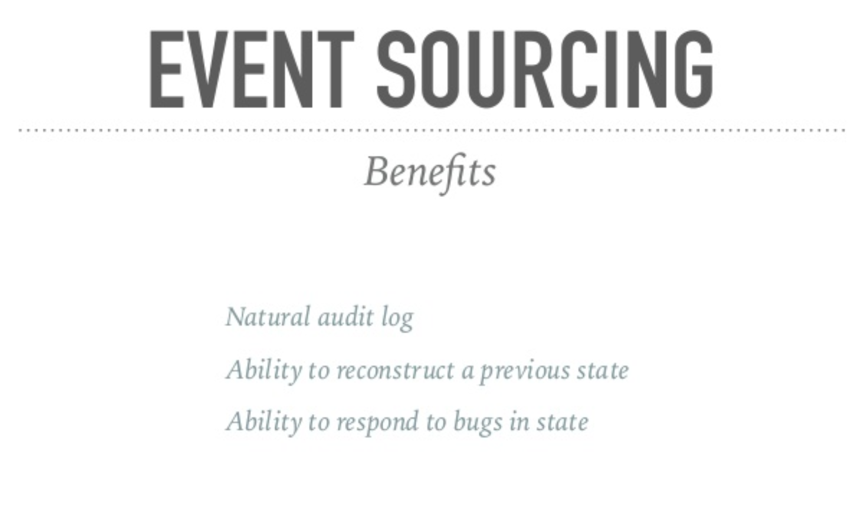

Slide 33
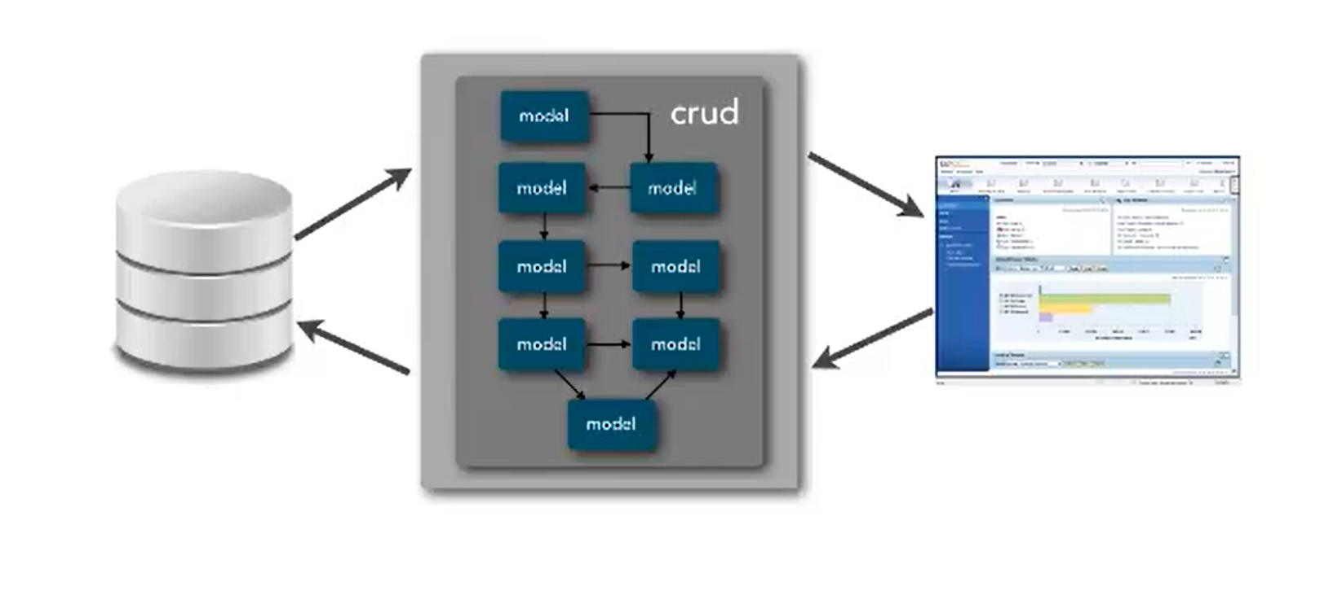
CQRS – Problem Discussion Command Query Responsibility Segregation

Slide 34
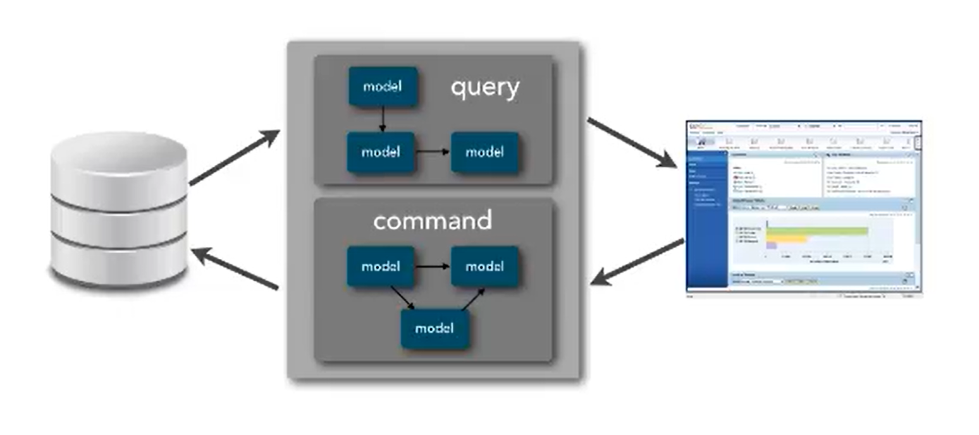
CQRS – Problem Discussion Command Query Responsibility Segregation

Slide 35
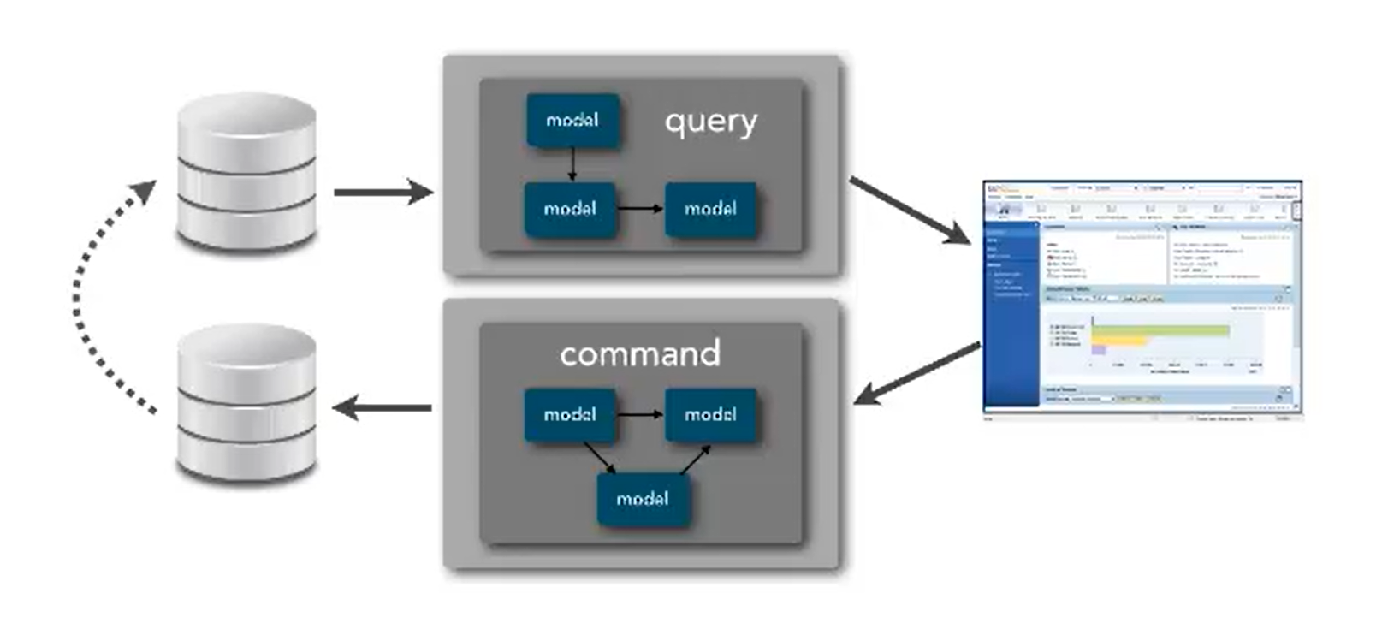
CQRS – Problem Discussion Command Query Responsibility Segregation

Slide 36
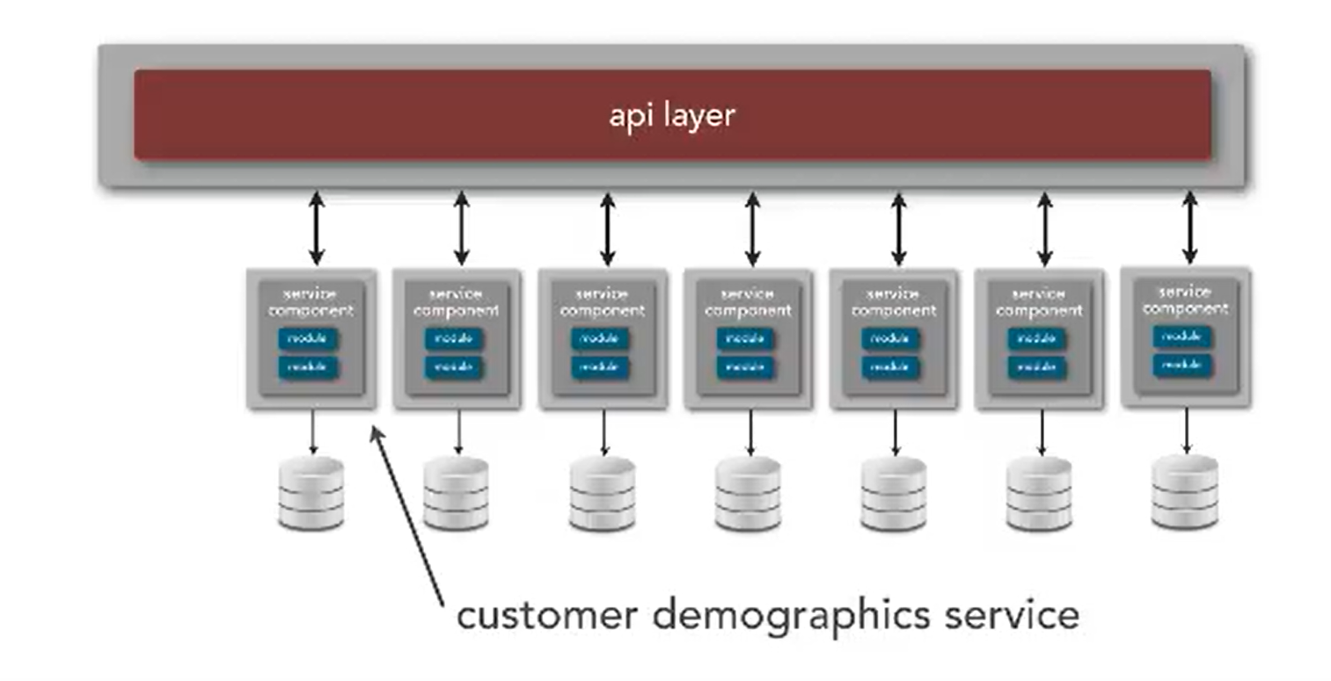
CQRS – Problem Discussion Command Query Responsibility Segregation

Slide 37
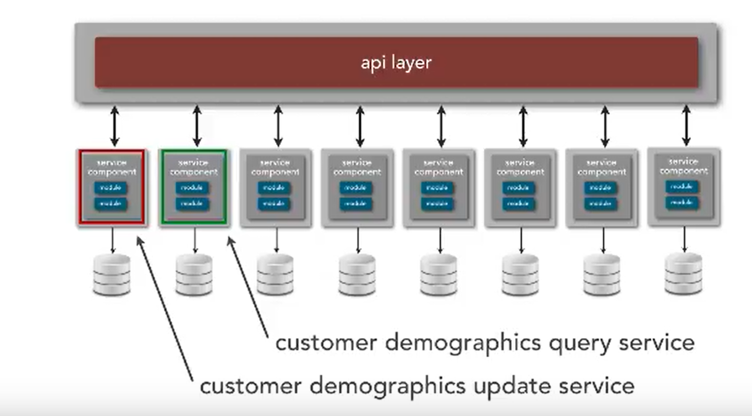
CQRS – Problem Discussion Command Query Responsibility Segregation

Slide 38
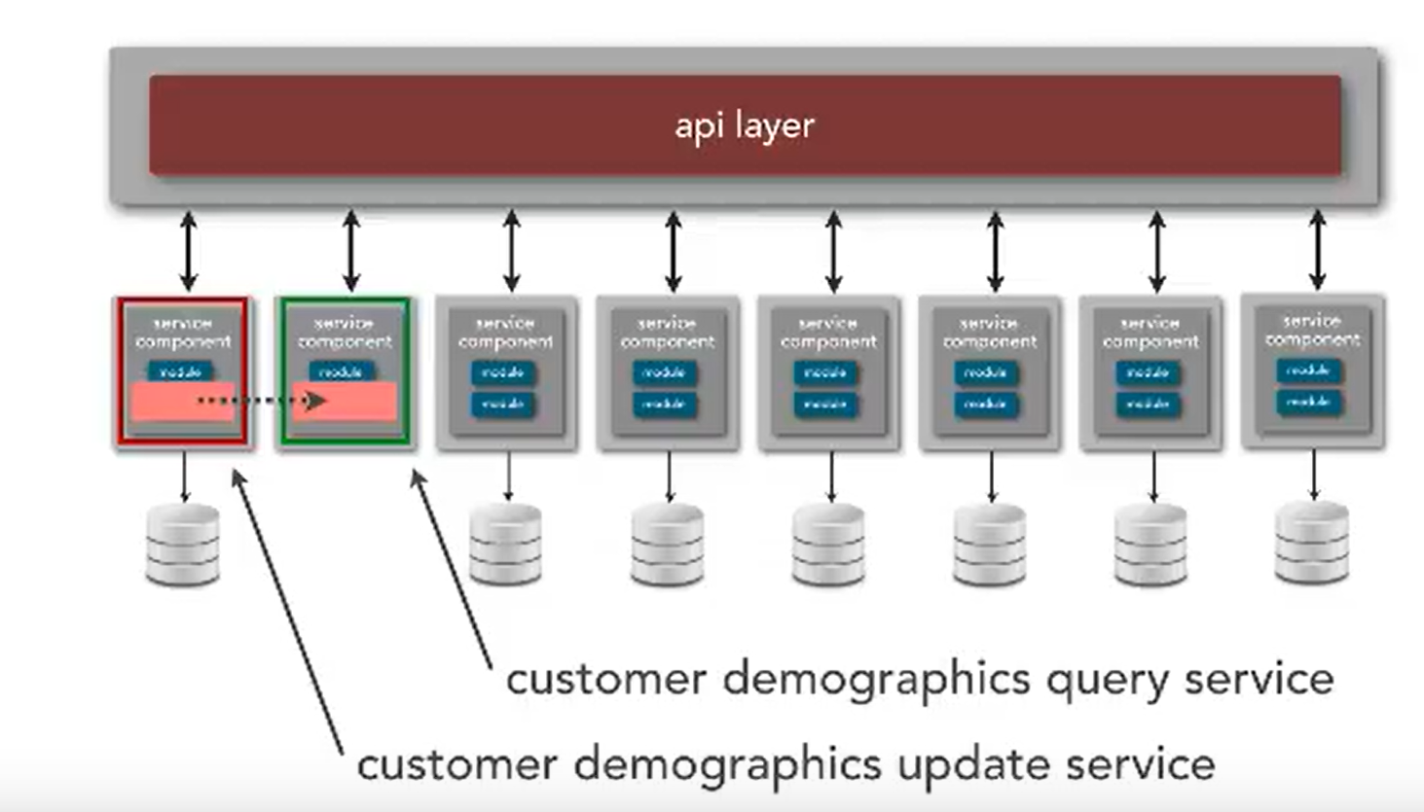
CQRS – Problem Discussion Command Query Responsibility Segregation

Slide 39
Saga Pattern
How to implement business transactions using Microservices

Slide 40
Transactions & Microservice Architecture
Transactions are an essential part of applications.
Without them, it would be impossible to maintain data consistency.
One of the most powerful types of transactions is called a Two-Phase Commit
It is useful especially when you have to update multiples entities at the same time
But in Microservice Architecture, each service is a system apart with its own database, and you no longer can leverage the simplicity of local two-phase-commits
Notes:
Transactions are an essential part of applications. Without them, it would be impossible to maintain data consistency.
One of the most powerful types of transactions is called a Two-Phase Commit, which is in summary when the commit of a first transactions depends on the completion of a second. It is useful especially when you have to update multiples entities at the same time, like confirming an order and updating the stock at once.
However, when you are working with Microservices, for example, things get more complicated. Each service is a system apart with its own database, and you no longer can leverage the simplicity of local two-phase-commits to maintain the consistency of your whole system.

Slide 41
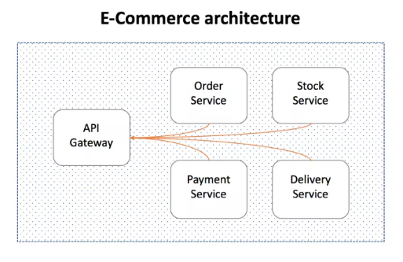
Microservices architecture
Consider the following high-level Microservices architecture of an e-commerce system.
Notes:
In the example above, one can’t just place an order, charge the customer, update the stock and send it to delivery all in a single ACID transaction. To execute this entire flow consistently, you would be required to create a distributed transaction.
We all know how difficult is to implement anything distributed, and transactions, unfortunately, are not an exception. Dealing with transient states, eventual consistency between services, isolations, and rollbacks are scenarios that should be considered during the design phase.
Fortunately, we already came up with some good patterns for it as we have been implementing distributed transactions for over 20 years now. The one that I would like to talk about today is called Saga pattern.

Slide 42
The SAGA Pattern
One of the most well-known patterns for distributed transactions is called Saga.
A saga is a sequence of local transactions where each transaction updates data within a single service.
The first transaction is initiated by an external request corresponding to the system operation
Then each subsequent step is triggered by the completion of the previous one.

Slide 43
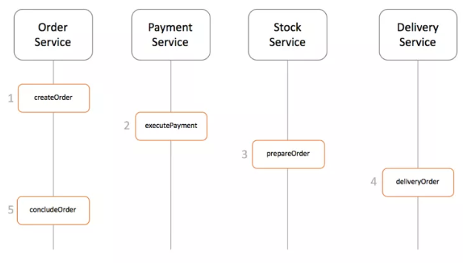
High-level design a saga implementation

Slide 44
Implementing a saga transaction
The two most popular are ways to implement a saga transaction
Events/Choreography: When there is no central coordination, each service produces and listen to other service’s events and decides if an action should be taken or not.
Command/Orchestration: When a coordinator service is responsible for centralizing the saga’s decision making and sequencing business logic

Slide 45
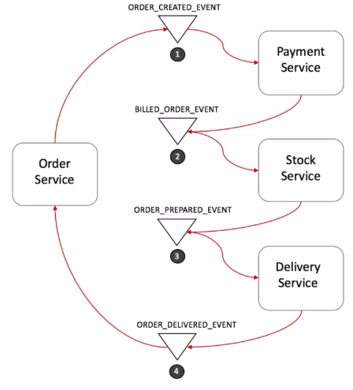
Events/Choreography
Notes:
In the Events/Choreography approach, the first service executes a transaction and then publishes an event. This event is listened by one or more services which execute local transactions and publish (or not) new events.
The distributed transaction ends when the last service executes its local transaction and does not publish any events or the event published is not heard by any of the saga’s participants.
Order Service saves a new order, set the state as pending and publish an event called ORDER_CREATED_EVENT.
The Payment Service listens to ORDER_CREATED_EVENT, charge the client and publish the event BILLED_ORDER_EVENT.
The Stock Service listens to BILLED_ORDER_EVENT, update the stock, prepare the products bought in the order and publish ORDER_PREPARED_EVENT.
Delivery Service listens to ORDER_PREPARED_EVENT and then pick up and deliver the product. At the end, it publishes an ORDER_DELIVERED_EVENT
Finally, Order Service listens to ORDER_DELIVERED_EVENT and set the state of the order as concluded.
In the case above, if the state of the order needs to be tracked, Order Service could simply listen to all events and update its state.

Slide 46
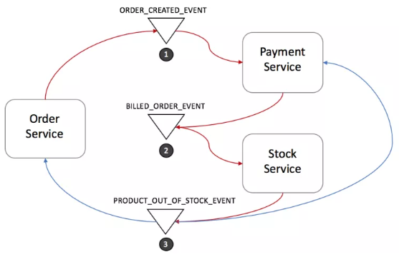
Rollbacks in Events/Choreography
Notes:
Rolling back a distributed transaction does not come for free. Normally you have to implement another operation/transaction to compensate for what has been done before.
Stock Service produces PRODUCT_OUT_OF_STOCK_EVENT;
Both Order Service and Payment Service listen to the previous message:
Payment Service refund the client
Order Service set the order state as failed
Note that it is crucial to define a common shared ID for each transaction, so whenever you throw an event, all listeners can know right away which transaction it refers to.
Events/Choreography is a natural way to implement Saga’s pattern, it is simple, easy to understand, does not require much effort to build, and all participants are loosely coupled as they don’t have direct knowledge of each other. If your transaction involves 2 to 4 steps, it might be a very good fit.
However, this approach can rapidly become confusing if you keep adding extra steps in your transaction as it is difficult to track which services listen to which events. Moreover, it also might add a cyclic dependency between services as they have to subscribe to one another’s events.

Slide 47
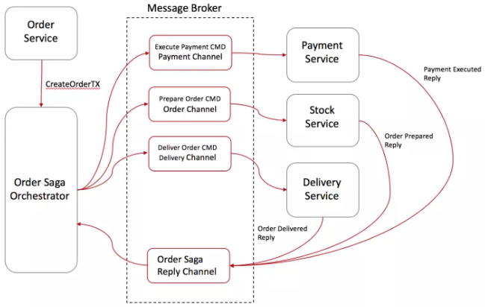
Command/Orchestration
Notes:
In the orchestration approach, we define a new service with the sole responsibility of telling each participant what to do and when. The saga orchestrator communicates with each service in a command/reply style telling them what operation should be performed.
Order Service saves a pending order and asks Order Saga Orchestrator (OSO) to start a create order transaction.
OSO sends an Execute Payment command to Payment Service, and it replies with a Payment Executed message
OSO sends a Prepare Order command to Stock Service, and it replies with an Order Prepared message
OSO sends a Deliver Order command to Delivery Service, and it replies with an Order Delivered message
A standard way to model a saga orchestrator is a State Machine where each transformation corresponds to a command or message.
State machines are an excellent pattern to structure a well-defined behavior as they are easy to implement and particularly great for testing.

Slide 48
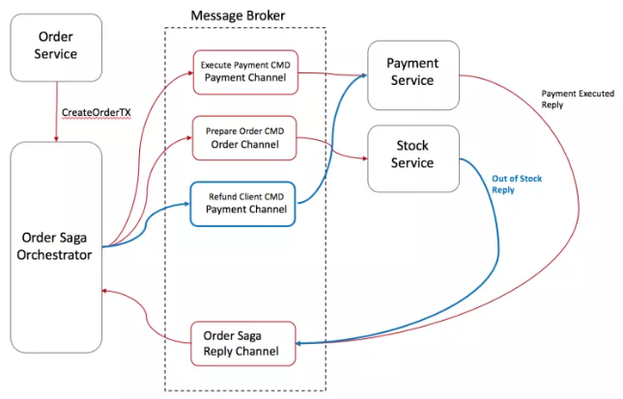
Rollbacks in Command/Orchestration
Notes:
Stock Service replies to OSO with an Out-Of-Stock message;
OSO recognizes that the transaction has failed and starts the rollback
In this case, only a single operation was executed successfully before the failure, so OSO sends a Refund Client command to Payment Service and set the order state as failed

Slide 49
Saga Pattern Tips
Create a unique Id per Transaction
Add the reply address within the command
Idempotent operations
Avoiding Synchronous Communications
Notes:
Create a unique Id per Transaction
Having a unique identifier for each transaction is a common technique for traceability, but it also helps participants to have a standard way to request data from each other. By using a transaction Id, for instance, Delivery Service could ask Stock Service where to pick up the products and double check with the Payment Service if the order was paid.
Add the reply address within the command
Instead of designing your participants to reply to a fixed address, consider sending the reply address within the message, this way you enable your participants to reply to multiple orchestrators.
Idempotent operations
If you are using queues for communication between services (like SQS, Kafka, RabbitMQ, etc.), I personally recommended you make your operations Idempotent. Most of those queues might deliver the same message twice.
It also might increase the fault tolerance of your service. Quite often a bug in a client might trigger/replay unwanted messages and mess up with your database.
Avoiding Synchronous Communications
As the transaction goes, don’t forget to add into the message all the data needed for each operation to be executed. The whole goal is to avoid synchronous calls between the services just to request more data. It will enable your services to execute their local transactions even when other services are offline.

Slide 50
Cross-Cutting Concerns
Some concerns cut across the entire system. These are the things you need every microservice to do, and they’re often related to keeping the system healthy in production:
Monitoring
Logging errors, requests, performance
Security
Policies related to technologies you use in many microservices—for example, handling database connections

Slide 51
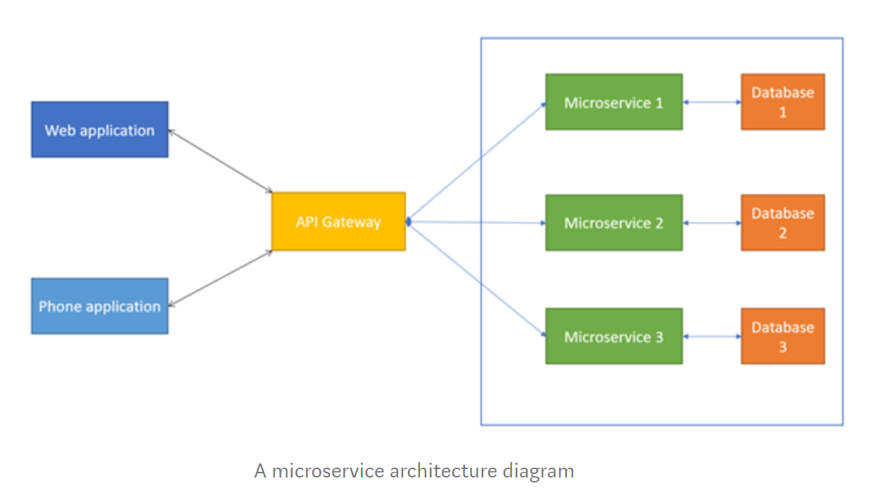
API Gateway
Notes:
However, applying API Gateway has both benefits and drawbacks. The biggest benefit of API Gateway is that clients just have to talk to the gateway rather than calling to a specific API. It also simplifies client codes.
The API Gateway also becomes development bottleneck. Because developers have to update the API Gateway if want to expose their APIs to external. That is why the process for updating API Gateway should be as lightweight as possible. If not, the developer will have to wait in line in order to update API Gateway.

Slide 52
Features of API Gateway
Routing
API Composition
Caching
Logging
Integrate with Identity Provider
Rate limiting
Notes:
Routing: This is one of the key functions of an API Gateway. Basically, when API Gateway receives a request from external, it will forward the request to correspondence internal API based on routing map. This feature is identical to reserve proxy feature provided by web servers like NGINX.
API Composition: An API Gateway not only acts like reverse proxy but also implements some API operations using API composition. For example, your application provides a “Reporting” function, this function requires involving of 3 APIs (GetProducts, GetBill and GetInventory) that belong to 3 different services: Product, Payment and Inventory. Without API Gateway, your font-end project will have to call three times to three APIs, instead, we just need to implement an API Gateway using API composition feature in order to expose only one endpoint to external (Reporting). It will help the font-end project to efficiently retrieve data by a single API request.
Caching: Cache responses in order to reduce requests to the services.
Logging: logging feature is necessary for tracing and debugging.
Integrate with Identity Provider: instead of integrating with Identity Provider for authentication and authorization on each service, we can centralize this inside API Gateway.
Rate limiting: limiting how many requests per second are allowed on a specific client or all clients.

Slide 53
API Gateway frameworks
Commercial - NGNIX, Kong, Tyk, APIGee
Azure API Management
AWS API Gateway
Ocelot (Open-source API Gateway built on ASP.Net Core)

Slide 54
Robustness
Dynamic environments and distributed systems - like microservices - lead to a higher chance of failures.
Services should fail separately, achieve graceful degradation to improve user experience.
70% of the outages are caused by changes, reverting code is not a bad thing.
Fail fast and independently. Teams have no control over their service dependencies.
Architectural patterns and techniques like caching, bulkheads, circuit breakers and rate-limiters help to build reliable microservices.

